Slide 1

Learning
Chapter 6

Slide 2
Agenda
Overview of learning
Observational learning
Operant conditioning
Latent learning
Classical conditioning
The who’s who in learning

Slide 3

What is behaviorism?

Slide 4
Laying the Groundwork
Reflexes versus instincts
Observational learning
The ABC’s of learning:
Antecedent – Behavior – Consequence
Associative learning

Slide 5
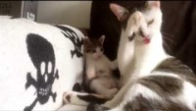
Observational learning
Models
Live, verbal, and symbolic
Vicarious reinforcement & vicarious punishment
Albert Bandura – Social Learning Theory

Slide 6
What is radical behaviorism?

Slide 7
Operant Conditioning

Slide 8
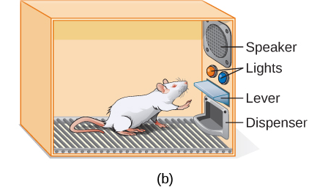
The “Skinner Box”
B.F. Skinner – known for the development of operant conditioning
Thorndike’s Law of Effect- Behaviors that are followed by consequences that are satisfying to the organism are likely to be repeated, and behaviors followed by unpleasant consequences are less likely to be repeated

Slide 9
Consequences- Explanation
 | Reinforcement | Punishment
Positive | Something is added to increase the likelihood of a behavior. | Something is added to decrease the likelihood of a behavior.
Negative | Something is removed to increase the likelihood of a behavior. | Something is removed to decrease the likelihood of a behavior.

Slide 10
Consequences- Examples
 | Reinforcement | Punishment
Positive | A child receiving candy for cleaning their room. | Spanking a child for screaming in a restaurant.
Negative | Wearing gloves in very cold weather, removing the pain. | Taking away a teenager’s electronics after they had an attitude.

Slide 11
Demonstration
Who would like to volunteer as tribute?

Slide 12
Shaping
Shaping- rewarding successive approximations of a target behavior.
Behaviors are broken into small, achievable steps:
Reinforce any response that resembles the desired behavior.
Then reinforce the response that more closely resembles the desired behavior. You will no longer reinforce the previously reinforced response.
Next, begin to reinforce the response that even more closely resembles the desired behavior.
Continue to reinforce closer and closer approximations of the desired behavior.
Finally, only reinforce the desired behavior.

Slide 13
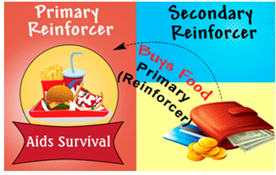
Primary and Secondary reinforcers

Slide 14
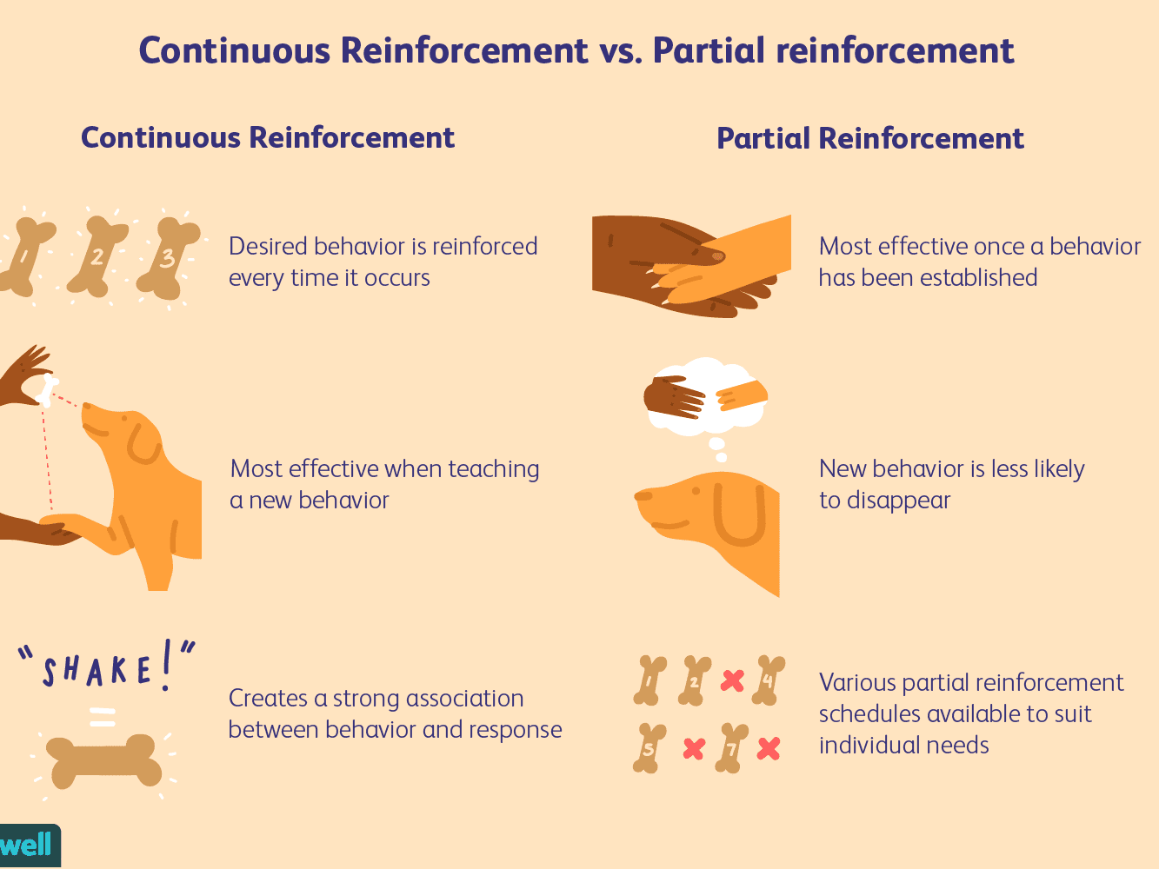
Continuous vs. Partial reinforcement

Slide 15
Reinforcement Schedules
Reinforcement Schedule | Description | Result | Example
Fixed interval | Reinforcement is delivered at predictable time intervals (e.g., after 5, 10, 15, and 20 minutes). | Moderate response rate with significant pauses after reinforcement | Hospital patient uses patient-controlled, doctor-timed pain relief
Variable interval | Reinforcement is delivered at unpredictable time intervals (e.g., after 5, 7, 10, and 20 minutes). | Moderate yet steady response rate | Checking Facebook
Fixed ratio | Reinforcement is delivered after a predictable number of responses (e.g., after 2, 4, 6, and 8 responses). | High response rate with pauses after reinforcement | Piecework—factory worker getting paid for every x number of items manufactured
Variable ratio | Reinforcement is delivered after an unpredictable number of responses (e.g., after 1, 4, 5, and 9 responses). | High and steady response rate | Gambling

Slide 16
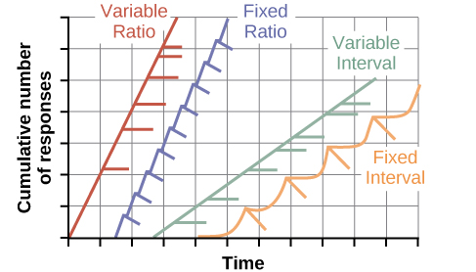
Reinforcement Schedules

Slide 17
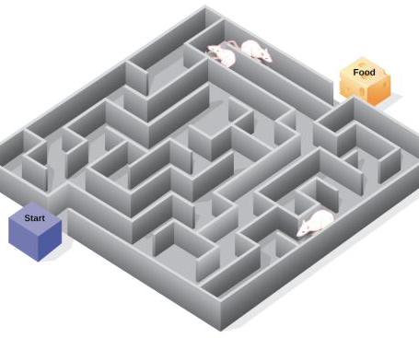
Latent Learning
Edward Tolman
Found that rats can create cognitive maps
Rats could learn over a series of maze runs, without a reward.
Then, a reward would be presented, and the rats would very quickly complete the maze
What we learned: we don’t always need an immediate reward to learn material (as opposed to radical behaviorism beliefs)

Slide 18

Classical Conditioning

Slide 19
Ivan Pavlov and the Development of Classical Conditioning

Slide 20
Classical Conditioning- The Pieces
The Originals: Unconditioned stimulus (UCS) and unconditioned response (UCR)
The New Guy: Neutral stimulus (NS)
The Remix: Conditioned stimulus (CS) and conditioned response (CR)

Slide 21
The Steps of Classical Conditioning
KEY
UCS: unconditioned stimulus
UCR: unconditioned response
NS: neutral stimulus
CS: conditioned stimulus
CR: conditioned response
Before Conditioning
Unconditioned stimulus causes unconditioned response, without any learning necessary
Neutral stimulus has no effect
X
UCS
UCR
NS
No Response

Slide 22
The Steps of Classical Conditioning
KEY
UCS: unconditioned stimulus
UCR: unconditioned response
NS: neutral stimulus
CS: conditioned stimulus
CR: conditioned response
During Conditioning
The neutral stimulus is repeatedly paired with the unconditioned stimulus, which still causes the unconditioned response
NS
UCS
UCR

Slide 23

The Steps of Classical Conditioning
KEY
UCS: unconditioned stimulus
UCR: unconditioned response
NS: neutral stimulus
CS: conditioned stimulus
CR: conditioned response
During Conditioning
The neutral stimulus becomes a conditioned stimulus
CONDITIONING
NS
CS

Slide 24
The Steps of Classical Conditioning
KEY
UCS: unconditioned stimulus
UCR: unconditioned response
NS: neutral stimulus
CS: conditioned stimulus
CR: conditioned response
After Conditioning
The conditioned stimulus now independently causes the conditioned response
NS
CR

Slide 25
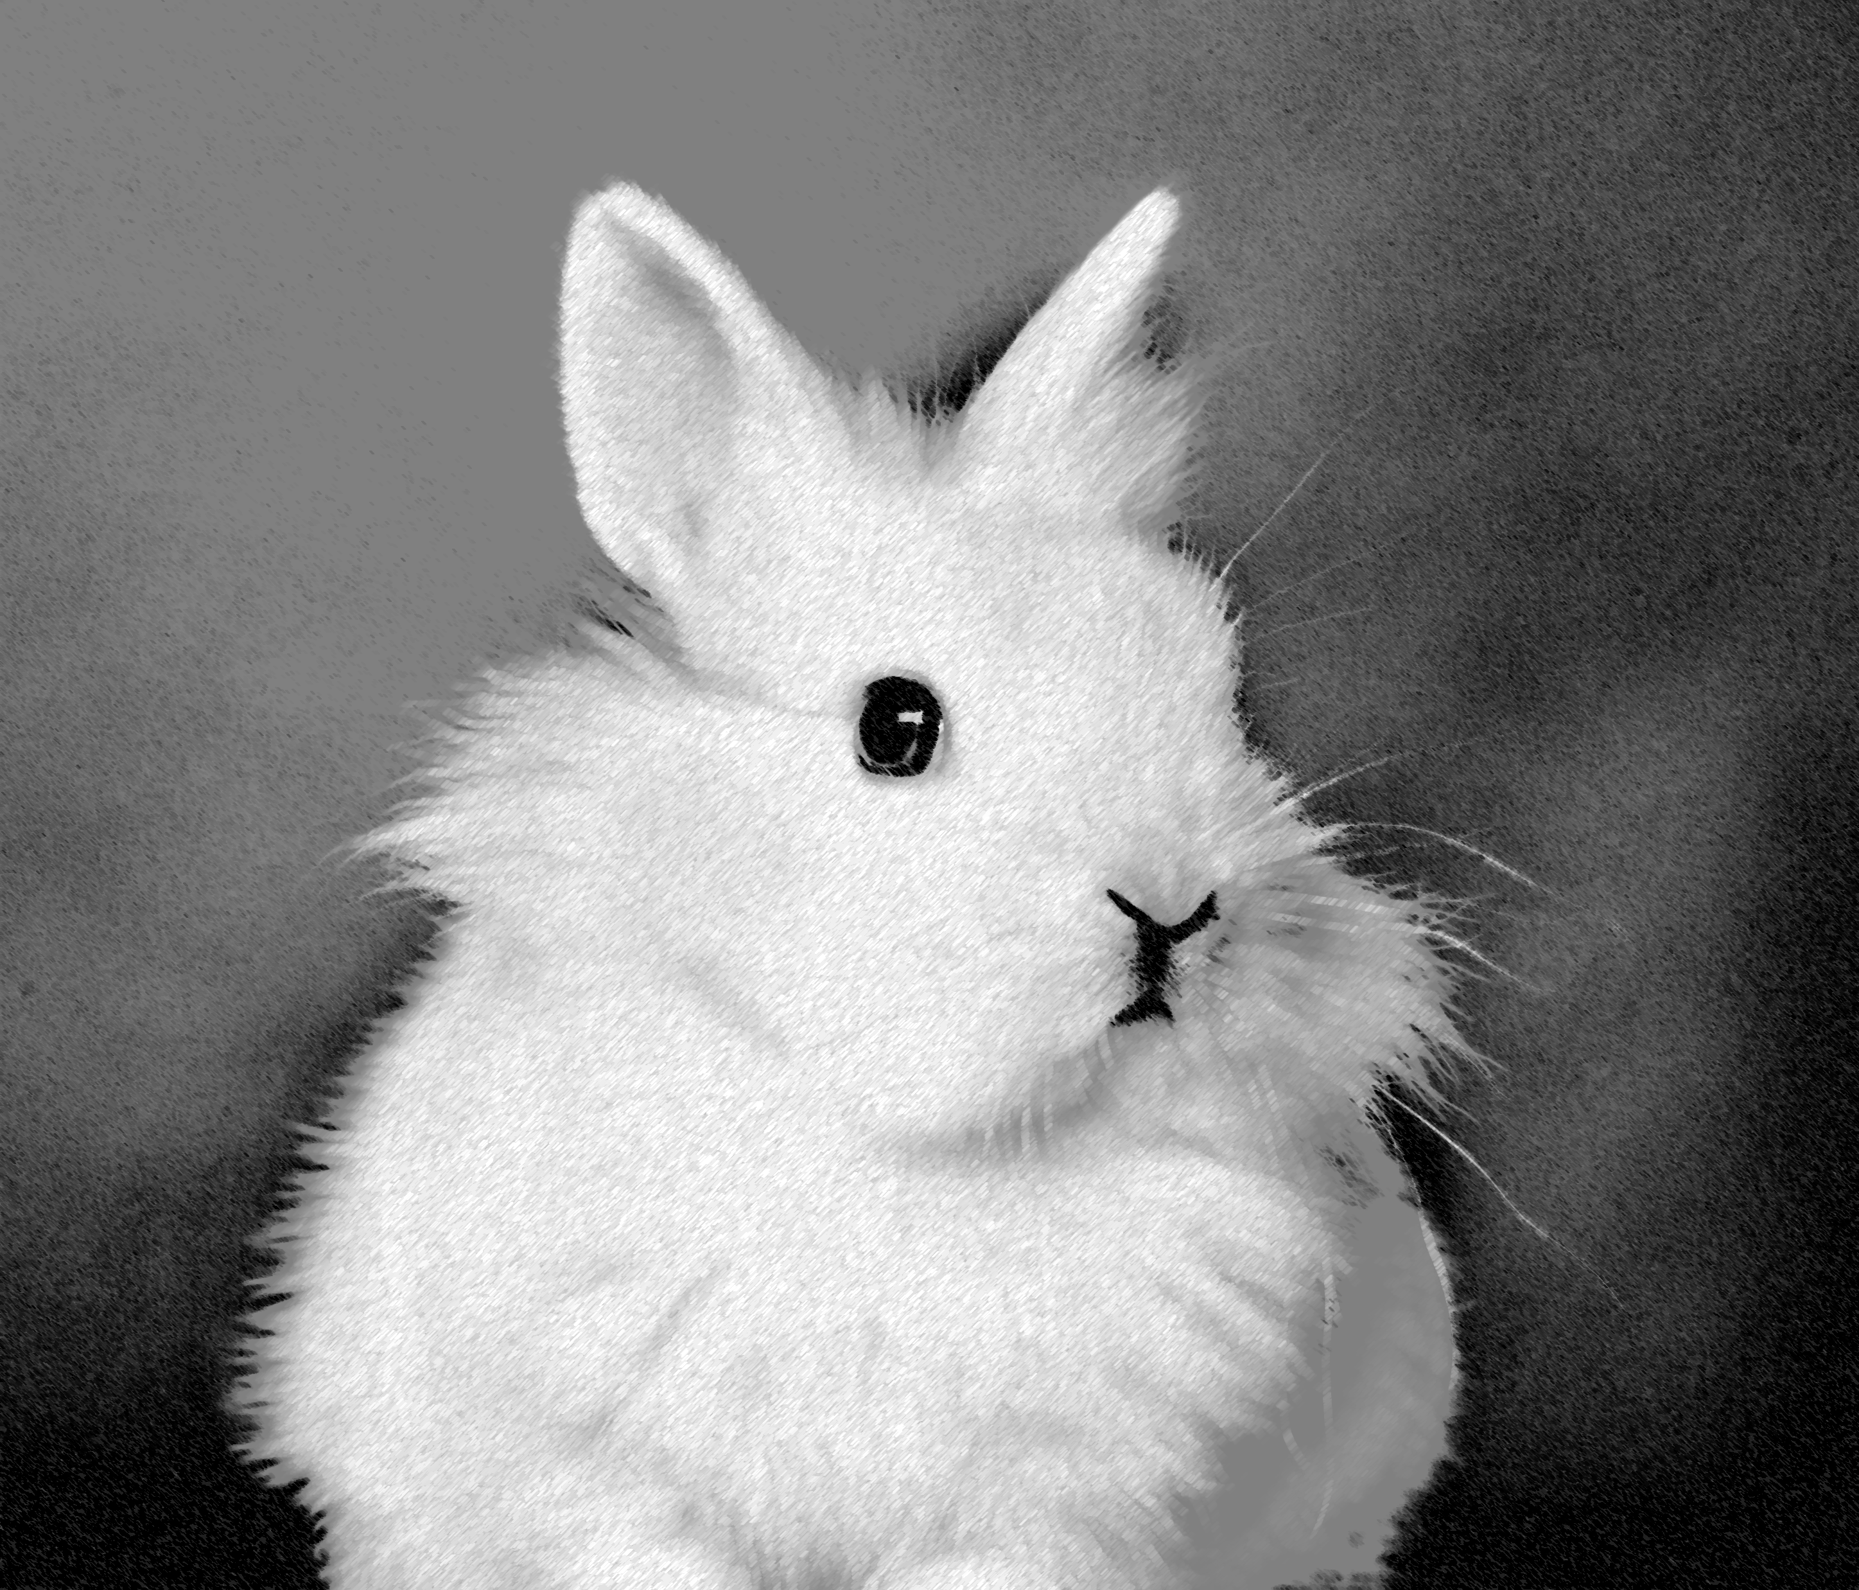
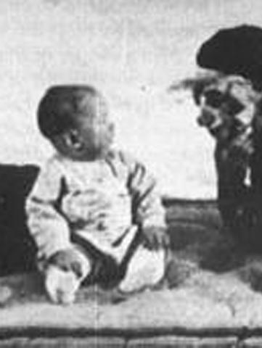
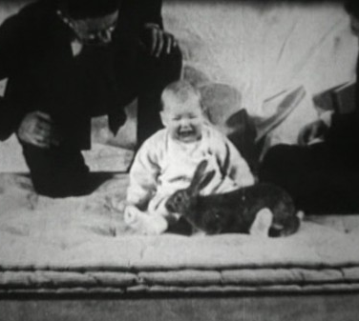
Classical Conditioning Done Wrong: Baby Albert

Slide 26
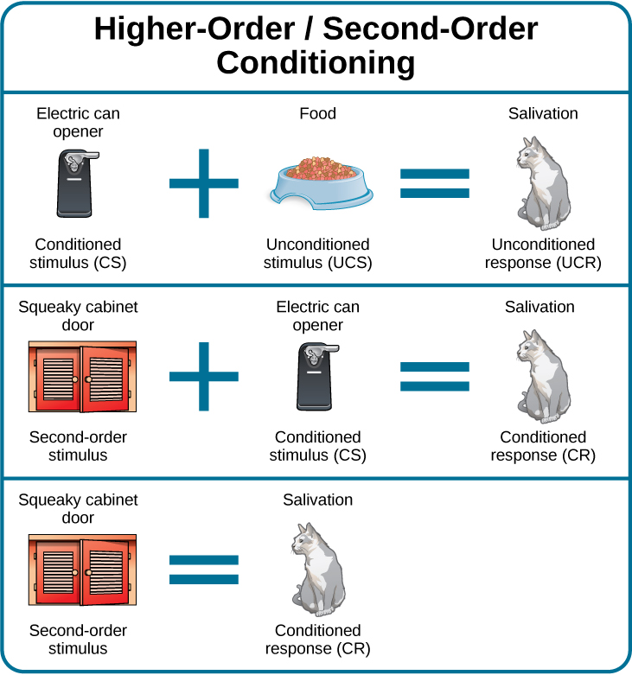
Higher-Order Conditioning

Slide 27
Processes in Classical Conditioning
Acquisition – The initial period of learning when an organism learns to connect a neutral stimulus and an unconditioned stimulus.
Extinction – The decrease in the conditioned response when the UCS is no longer presented with the CS.
Spontaneous recovery – The return of a previously extinguished conditioned response following a rest period.
Stimulus discrimination – When an organism learns to respond differently to various stimuli that are similar
Stimulus generalization – When an organism demonstrates the conditioned response to stimuli that are similar to the conditioned stimulus
Habituation – Learning not to respond to a stimulus that is presented repeatedly without change

Slide 28
People to Know
Ivan Pavlov
John Watson
B. F. Skinner
Edward Tolman
Albert Bandura
Developed classical conditioning
Founder of behaviorism
Developed operant conditioning
Social Learning Theory
Baby Albert study
Latent learning

Slide 29
Next Time on PSY 203…
Before Next Class:
Next Class:
Read Chapter 7
Take Chapter 7 Quiz
Due Thursday at 2pm
Potentially: Email Dr. S to make up exam points
Chapter 7 – Thinking and Intelligence

